Slide 1
Skytrax Data Scraping
Scraping Customer Reviews data into a .csv file using BeautifoulSoup and Python.

Slide 2
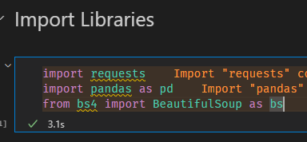
Import Necessary Libraries
For this web scraping process, we need 3 python libraries :
Pandas : For data manipulation
Requests : For send HTTP/1.1 requests
BeautifulSoup4 : For web scraping

Slide 3
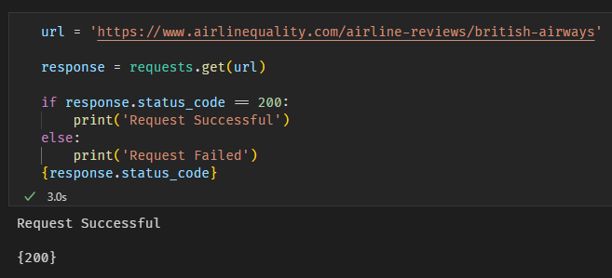
Initiate URL and Response Test
We then test the URL by sending a HTTP request, the result is code 200 which means our request is received.

Slide 4
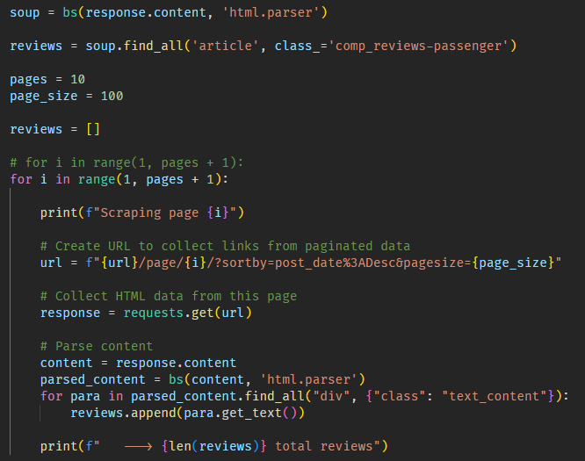
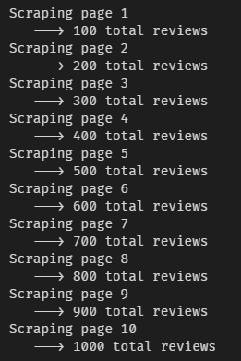
Scraping the Web
Now we began the scraping, first we need to scrape the reviews data on the website, collect links from paginated data, collect HTML data, and then parse the content. We collected 1000 Reviews data.

Slide 5
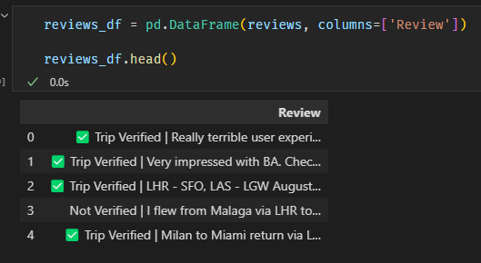

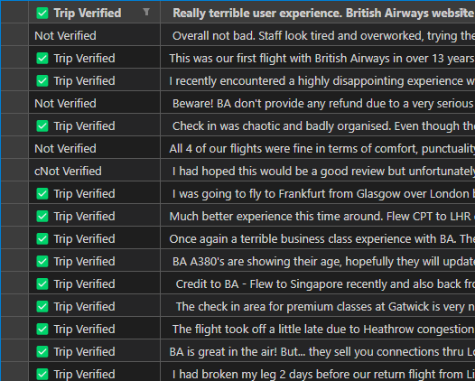
Create a Dataframe and Export to .csv
For easier data analysis, we could utilize pandas to create a dataframe and export the dataframe to a .csv file to better understand about the data.

